Slide 1
Approach
Data Sets
Training - 5136
Dev - 1284
Test – 1783
Models trained
2 Layer Conv-Net with 1 Fully Connected Layer
4 Layer Conv-Net with 1 Fully Connected Layer
2 Layer Conv-Net with 2 Fully Connected Layers
Data Cleaning and Augmentation
Dropping Training & Test cases with ‘NA’ values
Flipping Images horizontally
Applying Histogram Normalization

Slide 2
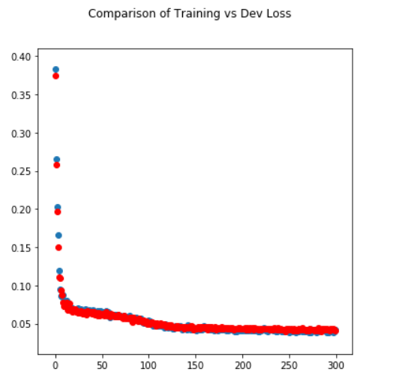
Model1 - 2 Layer Conv-net with 1 Fully connected Layer
Batch size = 400, epoch = 300
Data Sets | RMSE ( Epoch 299)
Training Set | 4.16%
Dev Set | 4.04%
Test Set (Kaggle) | 4.44%
Inference – Model does not over-fit the data.
Next Steps – Check if model’s bias can be reduced by introducing additional layers
Training Loss → Blue, Test Loss → Red

Slide 3
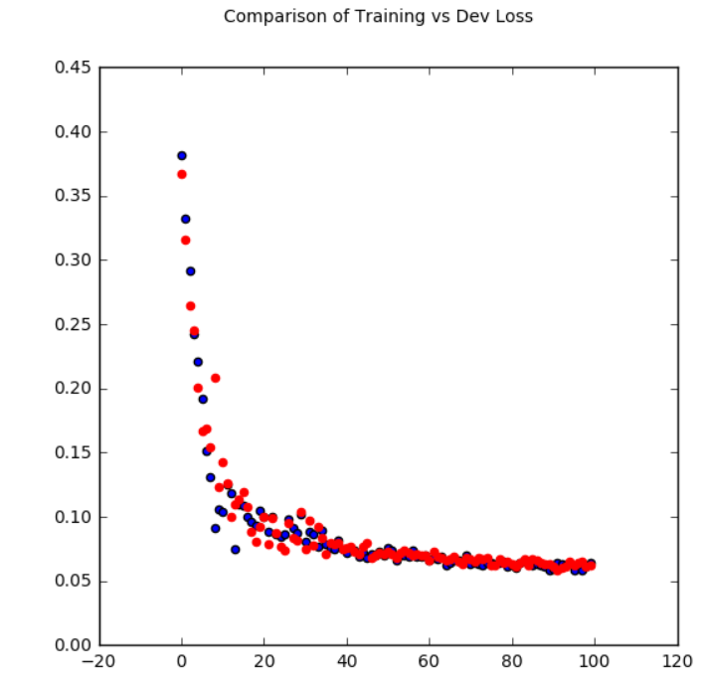
Model2 - 4 Layer Conv-net with 1 Fully connected Layer
Batch size = 400, epoch = 100
Data Sets | RMSE ( Epoch 99)
Training Set | 6.7%
Dev Set | 6.5%
Test Set (Kaggle) | 4.3%
Inference – Model still does not over-fit the data while improving the Kaggle score over Model1 .
Training Loss → Blue, Test Loss → Red

Slide 4
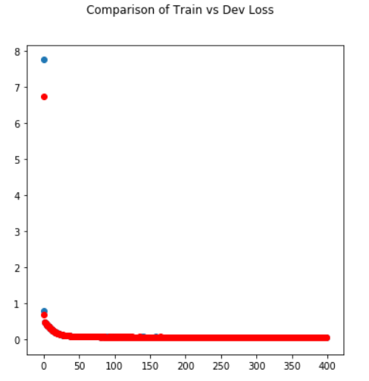
Model3 - 2 Layer Conv-net with 2 Fully connected Layers
Batch size = 400, epoch = 400
Data Sets | RMSE ( Epoch 399)
Training Set | 6.7%
Dev Set | 6.7%
Test Set (Kaggle) | 4.38%
Inference – Model has lowest loss variation between Training and Dev but the Kaggle score was slightly below Model2 .
Training Loss → Blue, Test Loss → Red

Slide 5
Questions
Why are we having different epochs for training different models? ( 300/100/400 for Models 1/2/3). Is it not necessary to have same epochs for comparing loss variation between dev and training sets of different models..
Should we not document running the models over test datasets and the prediction results?
Why was AdamOptimizer used instead of GradientDescentOptimizer?
What is the difference between Kaggle score and RMSE? ( Kaggle scores reported for each model and final summary numbers are different )
Is it required to have any performance comparison stats to justify data augmentation steps? ( horizontal flipping and histogram..)
We have not documented tuning the hyper parameters ( Stride, Padding) for each model . Is it something that we should mention in the Next steps section?
In the next steps, should we try a 4 layer Conv-Net with 2 fully connected layers?

